Slide 1


Real-Time Log Analytics
using AWS Services
Presented By:TeamETL
202418041(Palak Jain)
202418044(Kashish Patel)
202418051(Sheetal Jain)
202418056(Krishna Tank)
01

Slide 2
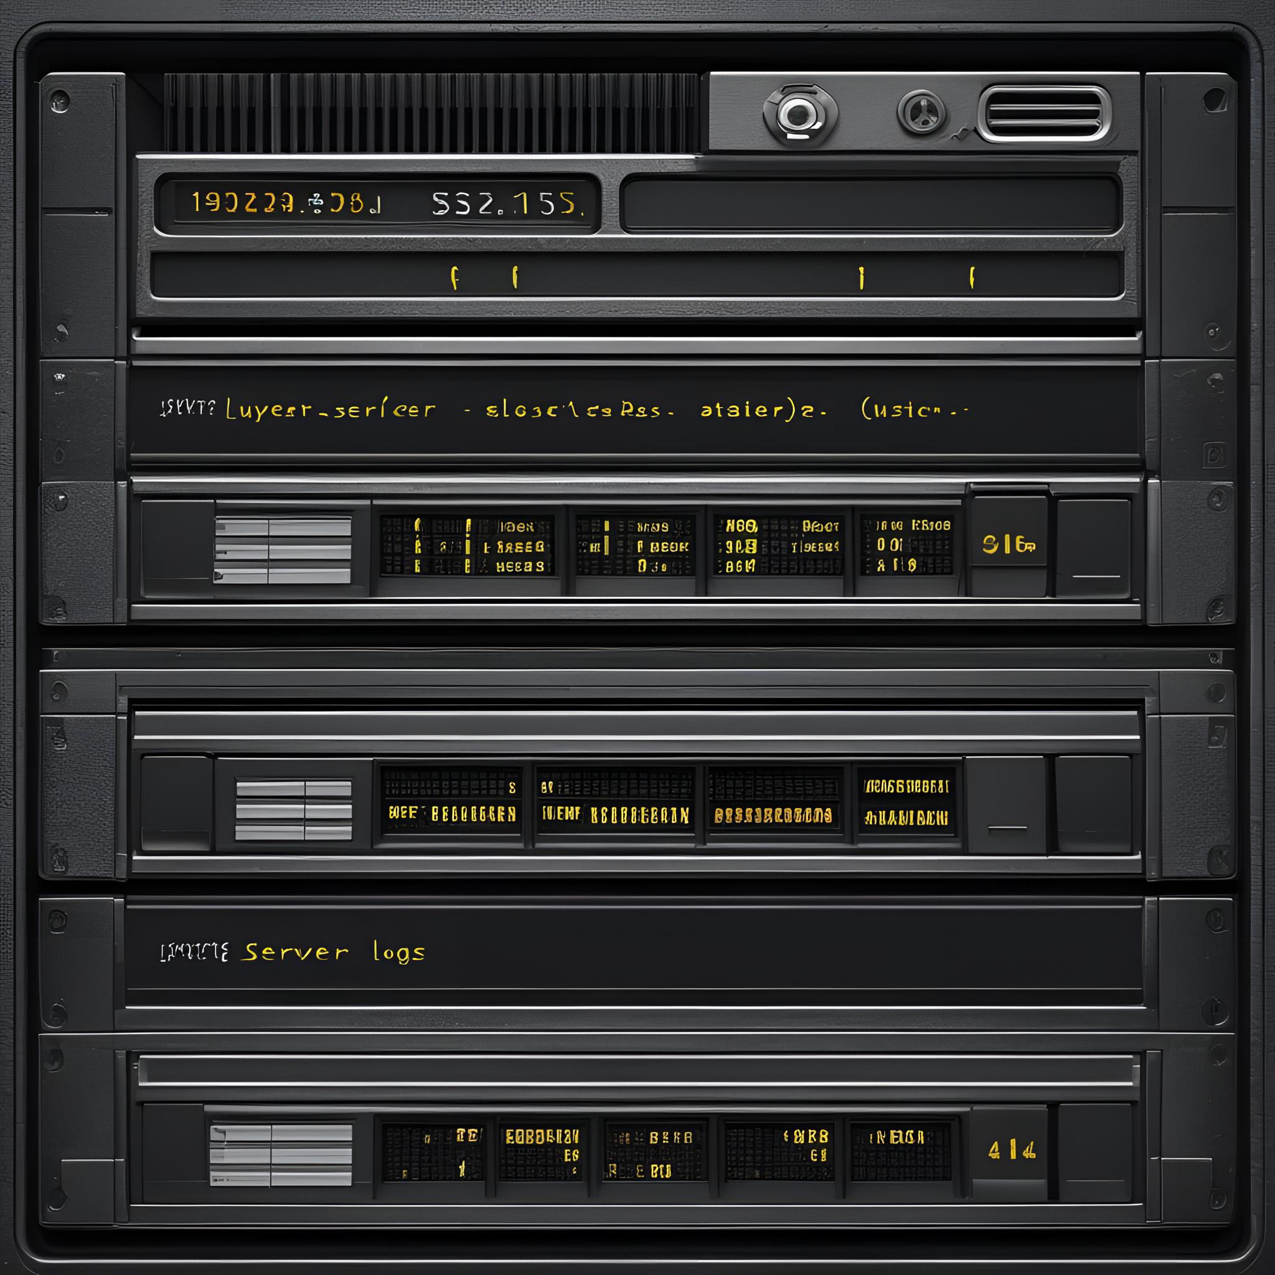
OBJECTIVE
To design a real-time data pipeline that collects, stores, processes, and queries server logs using AWS services like Python, S3, Glue, and Athena
Log ⟶ S3 ⟶ Glue ⟶ Athena
Page
02

Slide 3
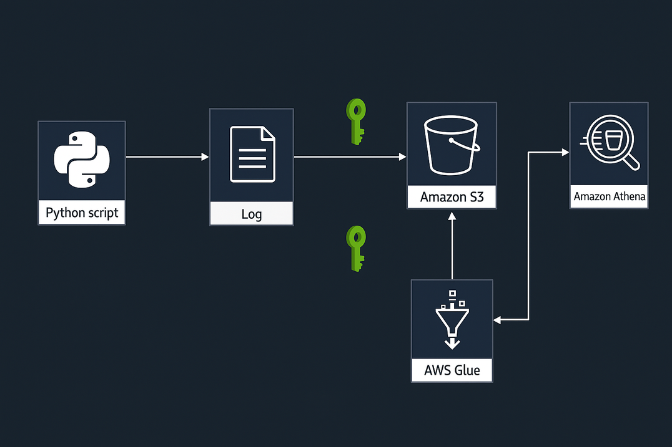
Pipeline
Python Script – Simulates real-time server logs and writes them to .parquet files.
Amazon S3 – Used as the central storage for partitioned .parquet log files (/YYYY/MM/DD/HH/).
AWS Glue – Crawls the S3 bucket to detect schema and create a table in the Data Catalog.
Amazon Athena – Runs SQL queries directly on the .parquet files stored in S3 using the Glue schema.
03

Slide 4
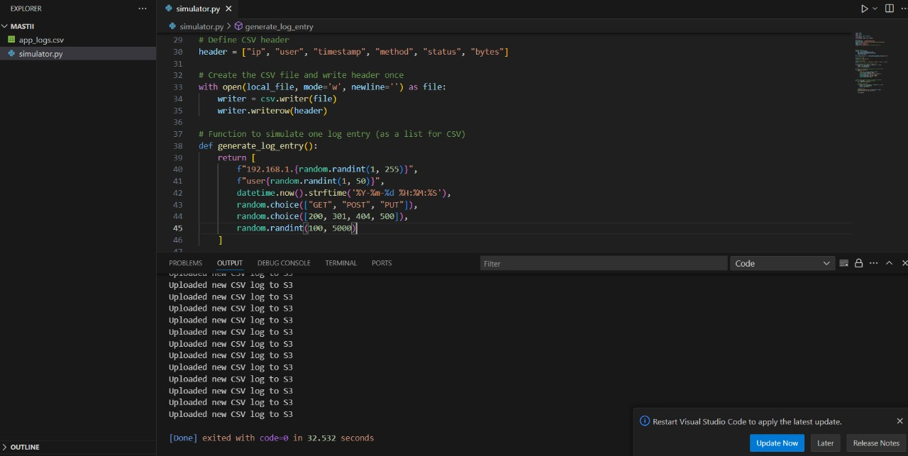
Log Generation
Used Python script to simulate real-time server logs.
Each log entry mimics an HTTP request with attributes like IP,
user, method, status code.
File format: .parquet
04

Slide 5
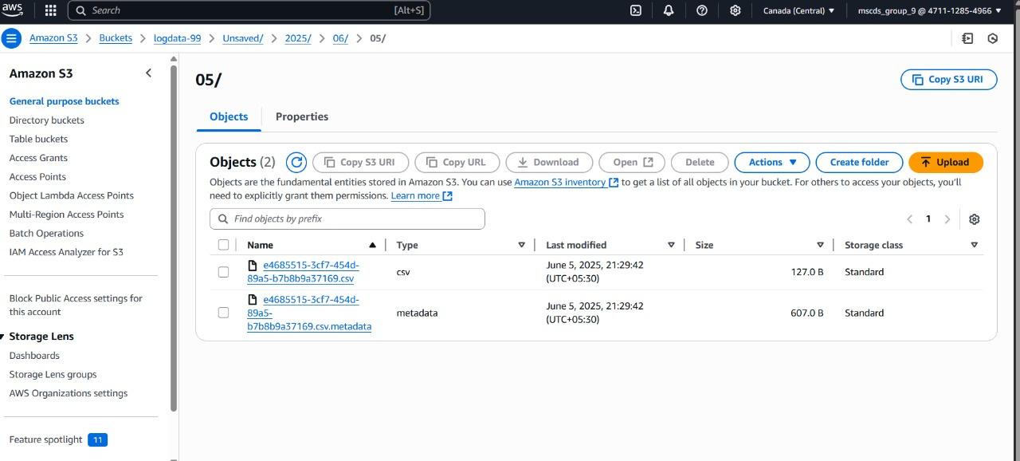
Data Delivery using Python + S3
Data was saved as .parquet files every 10 seconds.
Each file was uploaded directly to Amazon S3 using boto3.
File path followed partitioned structure:
s3://log-data-2025/YYYY/MM/DD/HH/app.parquet
05

Slide 6
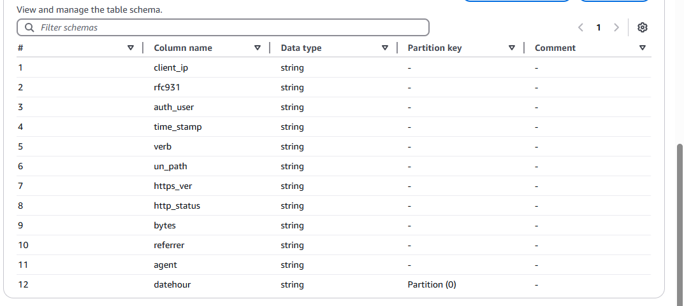
AWS Glue Schema and Table
06

Slide 7
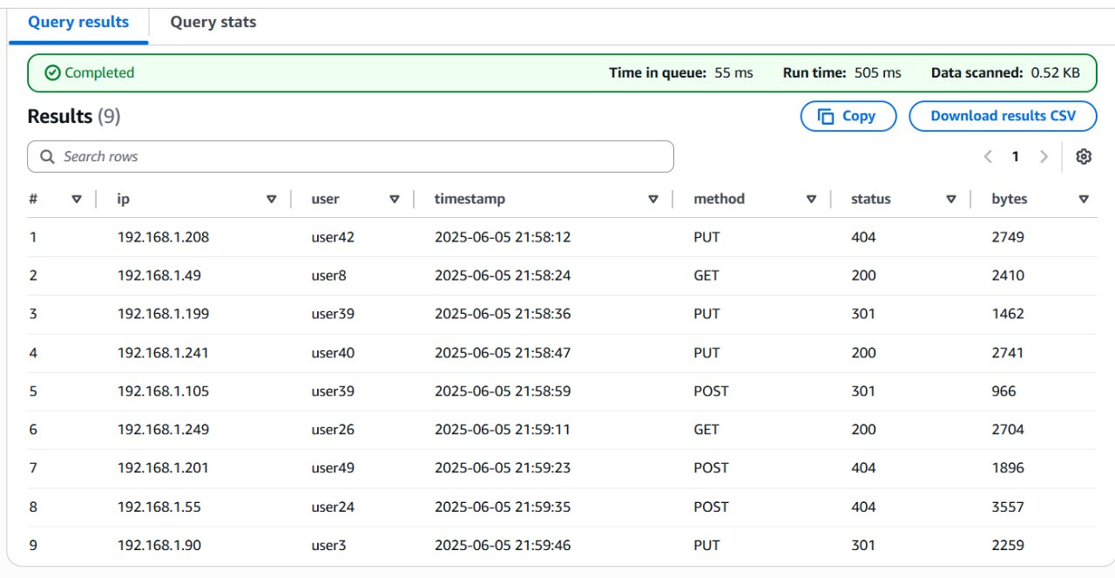
Querying Logs with AWS Glue + Athena
AWS Glue Crawler was configured to scan the S3 path and create a schema.
Schema detected fields like client_ip, auth_user, status_code, datehour, etc.
Partition column (datehour) detected and indexed for fast querying.
Queried the data using Amazon Athena (SQL over S3).
COMMAND - SELECT * FROM log_table LIMIT 10;
07

Slide 8
Why These AWS Services Were Chosen ?
Python Script + Boto3 : Used to simulate real-time data delivery to S3 without needing Firehose or EC2.
Amazon S3 : Durable, scalable object storage; ideal for storing time-partitioned log data.
AWS Glue Crawler : Automatically detects schema from .parquet files and populates Glue Data Catalog.
Amazon Athena : Serverless SQL-based querying over S3 without need for a database or ETL setup.
08

Slide 9
Conclusion
We built a complete log analytics pipeline using AWS to Real-time logs streamed successfully . Logs were generated locally, sent directly to S3 using a Python script, and organized with Glue. We queried the logs using Athena . The system is simple, scalable, and ready for real-time analysis.
09

Slide 10
Thank
You.
Page
8

